Slide 1
Get full version of ‘Accident Investigation and Root Cause Analysis’ book and PPT presentation for $25 Only
DOWNLOAD
Or visit - http://www.free-safety-training.com/product/accident-investigation-root-cause-analysis-ppt-pdf/

Slide 2
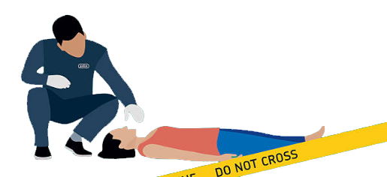
Incident Investigation And Root Cause Analysis

Slide 3
Learning Outcome
As a step-by-step guide, it will help all organisations, to carry out their own health and safety investigations. Investigating accidents and incidents explains why you need to carry out investigations and takes you through each step of the process:
Step one: Gathering the information
Step two: Analysing the information
Step three: Identifying risk control measures
Step four: The action plan and its implementation

Slide 4
Accident / Incident Statistics
As per HSE UK
In 2015/16

Slide 5
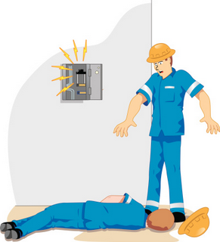
Accident / Incident Statistics
144 workers were killed as a result of a workplace accident.

Slide 6
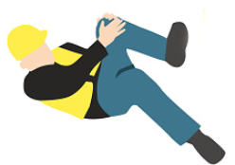
Accident / Incident Statistics
An estimated 621,000 workers sustained a non-fatal injury at work according to self-reports.

Slide 7

Accident / Incident Statistics
Over 2.3 million cases of ill health are caused or made worse by work.

Slide 8
Accident / Incident Statistics
“If you think safety is expensive, try an accident”
- Chairman of Easy Group

Slide 9
Accident / Incident Statistics
There are good financial reasons for reducing accidents and ill health.
Costings show that for every £1 a business spends on insurance, it can be losing between £8 and £36 in uninsured costs.

Slide 10
Accident / Incident Statistics
Triangle Model Of Incident Outcomes
1 Serious or disabling injury
10 Minor Injury (first aid)
30 Damage Only
600 Non-Damage/ Near miss

Slide 11

Some Definitions
What is an incident?
This is an unplanned, uncontrolled and undesired event that results in no harm, but has the potential to do so.

Slide 12
Some Definitions
What is near miss?
However the definition of an incident is wider in that it also includes dangerous occurrences and near misses. A near miss is an unplanned event that did not result in injury, illness, or damage - but had the potential to do so. Only a fortunate break in the chain of events prevented an injury, fatality or damage.

Slide 13

Some Definitions
What is near miss?

Slide 14
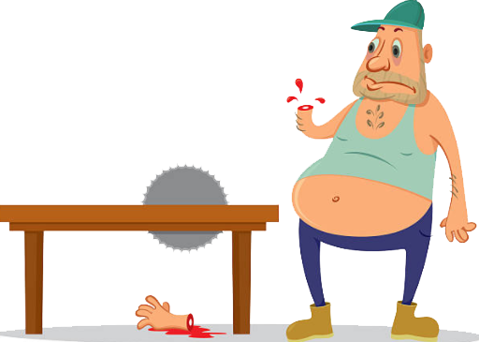
Some Definitions
What is an accident?
This is an unplanned, uncontrolled and undesired event which results in harm and/or property damage.

Slide 15

Some Definitions
What is dangerous occurrence?
One of a number of specific, reportable adverse events, as defined in the Reporting of Injuries, Diseases and Dangerous Occurrences Regulations 1995 (RIDDOR).

Slide 16
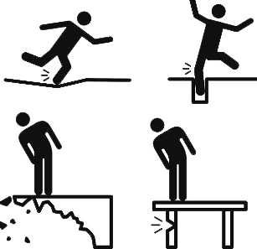
Some Definitions
What is hazard?
The potential to cause harm, including ill health and injury; damage to property, plant, products or the environment, production losses or increased liabilities.

Slide 17
Some Definitions
Risk
The level of risk is determined from a combination of the likelihood of a specific undesirable event occurring and the severity of the consequences (ie how often is it likely to happen, how many people could be affected and how bad would the likely injuries or ill health effects be?)

Slide 18
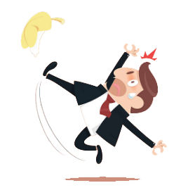
Some Definitions
Immediate cause
The most obvious reason why an adverse event happens, eg the guard is missing; the employee slips etc. There may be several immediate causes identified in any one adverse event.

Slide 19
Some Definitions
Underlying cause
The less obvious ‘system’ or ’organisational’ reason for an adverse event happening, eg pre-start-up machinery checks are not carried out by supervisors; the hazard has not been adequately considered via a suitable and sufficient risk assessment; production pressures are too great etc.

Slide 20
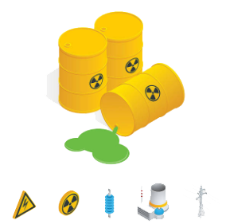
Some Definitions
Root cause
An initiating event or failing from which all other causes or failings spring. Root causes are generally management, planning or organisational failings.

Slide 21
Reasons for investigating accidents
Incidents should be investigated to identify the cause to prevent recurrence.

Slide 22
Reasons for investigating accidents
Other reason for investigating accidents
Determining the cost of accidents
Establish legal liability
Collect statistical data
Calculate costs
Improve practices
Identify trends

Slide 23
The causes of adverse events
Domino theory :
In 1931, the late H.W. Heinrich presented a model known as the ‘domino theory’ as this accident sequence was likened to a row of dominoes knocking each other down in a row.

Slide 24
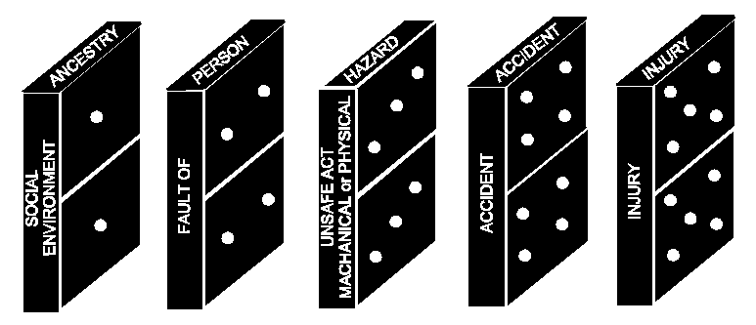
The causes of adverse events
Domino theory :

Slide 25
The causes of adverse events
Domino theory :
According to W.H. Heinrich (1931), all accidents are caused:
  88%
  of by unsafe acts of people
  10%
  by unsafe actions
  2%
  of industrial accidents are unavoidable

Slide 26
The causes of adverse events
Domino theory :
The sequence is:-
Injury, caused by an;
Accident, due to an;
Unsafe act and/or mechanical or physical hazard, due to the;
Fault of the Person, caused by their;
Ancestry and Social Environment.

Slide 27
The causes of adverse events
Domino effect:
Adverse events have many causes. What may appear to be bad luck (being in the wrong place at the wrong time) can, on analysis, be seen as a chain of failures and errors that lead almost inevitably to the adverse event.

Slide 28
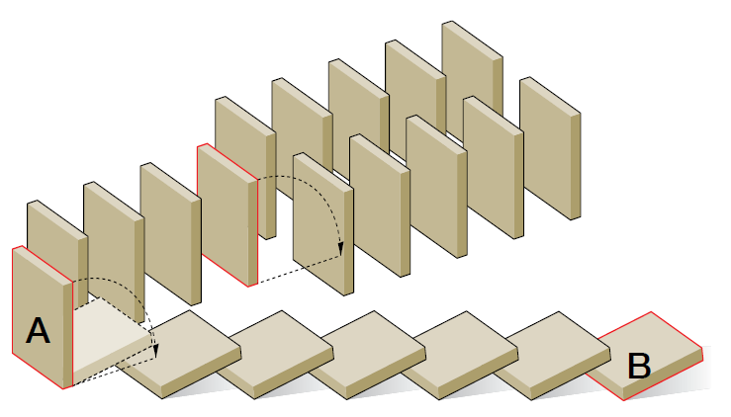
The causes of adverse events
Domino effect:
Figure - Sequence of dominoes

Slide 29
The causes of adverse events
Multiple Causation Theory
According to Peterson (1978), there is not only one causes behind to accidents. There are many factors, causes and sub-causes behind every accident. Under the concept of “multiple-causation”, the factors, causes, sub-causes combine together in random fashion and causing to accidents.

Slide 30
The causes of adverse events
Multiple Causation Theory
Unsafe Act
Unsafe Condition
  Failure to warn others of danger
  Leaving equipment in dangerous condition
  Working without authority
  Disconnecting safety devices
  Using defective/ wrong equipment
  Failure to use or wear PPE
  Horseplay/skylarking
  Inadequate or missing guards
  Fire hazards
  Poor housekeeping
  Noise
  Inadequate supervision
  Untrained staff

Slide 31
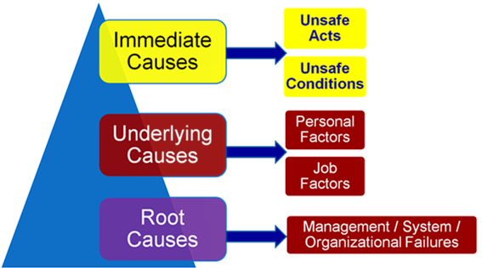
The causes of adverse events
Causes can be classified as:

Slide 32
Get full version of ‘Accident Investigation and Root Cause Analysis’ book and PPT presentation for $25 Only
DOWNLOAD
Or visit - http://www.free-safety-training.com/product/accident-investigation-root-cause-analysis-ppt-pdf/

